Slide 1

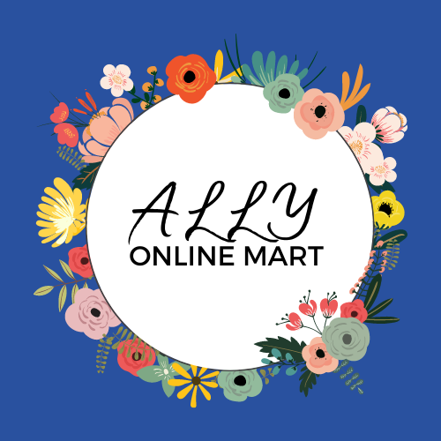
Team Bugs Bunnies
( Customer Delight )
Institute Name: National Institute of Technology Patna
Garima Singh : garingh128@gmail.com

Slide 2
PROBLEM STATEMENT
Customer Delight
Customer delight is the process of exceeding a customer’s expectations to create a positive customer experience with your product or brand to improve loyalty. Delighting customers is not just meeting their needs at the moment. It is more about building authentic relationships that stand the test of time. Delight is about providing a remarkable experience to users through focusing on their needs, interests, and wishes. Let’s figure out ways to delight our customers by helping them detect personalised trends from various happening and sources throughout India.
Figure out innovative ways to enhance user shopping experience using AR and VR technologies in an ecommerce scenario. Devise innovative ways to incorporate Trends into Fashion relevant flows like Designing and Merchandising

Slide 3
THE IDEA- ALLY
Ally is a conjunction that encapsulates effective features that will surely enhance customer satisfaction and delight and create a positive customer base for the brand along with innovative ways to incorporate Trends into Fashion relevant flows like Designing and Merchandising.
A dedicated news feed section in the mobile application to see what your friends and followed people are buying.
Feature to follow influencers or your relatives and friends on the app itself and a separate section where top trending influencers and celebrities endorse brands and you can buy the same outfits as them. Famous looks from upcoming movies can also be purchased.
Purposeful competitions can be a fun way to spread the word about the store. We can extract maximum exposure from competitions by building in a voting mechanic – in order to win or be shortlisted, participants have to get their friends to vote.
A separate section where customers can write authoritative, interesting content and blogs in online shop’s contextual domain and get paid for the same.
Refer a friend: Referrals can happen organically via Word of Mouth marketing or through a referral marketing program and customers get discounts for the frequency of referrals.

Slide 4
INNOVATION IN OUR PROPOSED SOLUTION
Hyper-personal product recommendations:For individualized service, blending AI and a human touch, style service Thread asks customers to complete a questionnaire and upload images of themselves. A stylist reviews the information to understand each client’s needs and uses the company’s AI algorithm to sort through thousands of products for personalized style suggestions.
A savvy social sales assistant: A machine learning tool or a bot to answer all queries of the customers.
To give retail companies certainty on up-to-the-minute fashion trends, AI can crawl e-commerce sites to pinpoint exactly which products are most visible. AI can also crawl social media sites to identify trends, helping brands be first to market with popular styles.
The best way to ensure the price is right: Big data tools help retailers maintain a competitive pricing strategy, combining AI and machine learning.
Add friends and chat option to share your choices and complete cart directly on the app with your online friends with no hassle of sharing links on other apps.

Slide 5
TECHNOLOGY STACK
OPERATING SYSTEM | ANDROID 4.0+ iOS 9.0+
BACKEND DATABASE | GOOGLE FIREBASE
PROGRAMMING LANGUAGE | JAVA 8 SQL XML
DESIGN SOFTWARES | ADOBE XD FIGMA
Software used : Android Studio

Slide 6
IMPACT
THE APP BASICALLY EASES THE TASK OF THE CUSTOMERS EASIER. Our main focus is to make the shopping experience for the customer base as smooth as possible. When we take the older generation into focus, they are still unsure about online shopping because of size related issues and other scams that happen on a daily basis. But adding some features as discussed will surely increase the customer delight experience. The impact of our application will be:
Gain in customer base
Cost effective as negligible need of external marketing as buyers will themselves draw more customers through referral programs and easy sharing of product links
Making a loyal customer base as we are not showing them vague random products but things that they actually need and wish for.
A completely different and personalised feed section for each and every customer, data of which can be gathered from their social media accounts and past history on the application.
AR/VR can help brands and merchants thrive post-coronavirus:
The ability to offer model diversity and allow customers to filter by model attributes is a value-add.
Virtual styling at scale enables greater merchandising personalization.The ability to serve different banners to different customers based on browser and profile data can tailor relevant experiences.
Social distancing in post covid era and Try before you buy feature

Slide 7
IMPLEMENTATION
Scope of the solution:
Mobile devices are increasingly being used as platforms for interactive services. The demand for a single integrated, easy-to-use, access to information applications and people within a network of users is increasing more and more. Therefore 'Ally' will be a perfect partner for eradication of present problems of online shopping customers. Our mobile portal is designed to increase accessibility to almost everything that a shopper needs. Once logged in, they will have access to a variety of tools and information.
The application currently has an Android based interface only.
When the user first authenticates himself, he lands on a dashboard which has several options based on his/her interest.
The working of the app is fuss-free and smooth in the sense that it uses completely hassle-free methods of storage and authentication.
The UI is currently under development but we intend to follow a same color scheme and pattern throughout the app.
In a nutshell:
SHOPPERS CALL FOR AN 'ALLY'
AND WE HOPE THAT OUR APP COMPLETES THE CIRCLE.

